Slide 1
Welcome to EDUC2323 Computer Programming as a Tool for Learning
Module Leader: Matthew Dean
mjdean@dmu.ac.uk

Slide 2
Plan
Module philosophy
Where did all this come from?
Getting started with Computational Thinking and Algorithms

Slide 3
Module Philosophy
Workshops will be collaborative and practical – we are building communities of practice (Wenger, McDermott & Snyder, 2002)
We are concerned about teaching, learning and thinking first, technology second
Computers and technology are ‘objects to think with’ – they offer ‘windows into learning’
We are learning conceptual building blocks, not specific technologies
Interdisciplinary approaches – people with different backgrounds encouraged to share expertise
There are no stupid questions – absolutely none…

Slide 4
Criticism of Taught Computing in Schools
Is IT teaching up to scratch?
The ancient language our kids lack: computer code
' Dull' computer classes to be ditched
University applications are falling in exactly the subjects that are increasingly needed.
Classrooms must support the UK's technology boom
Program or be Programmed!
British teenagers can't code. Until they learn how to, they're stuffed - and so is the UK
IT teaching faces shake-up after Google criticism
Programming should take pride of place in schools

Slide 5
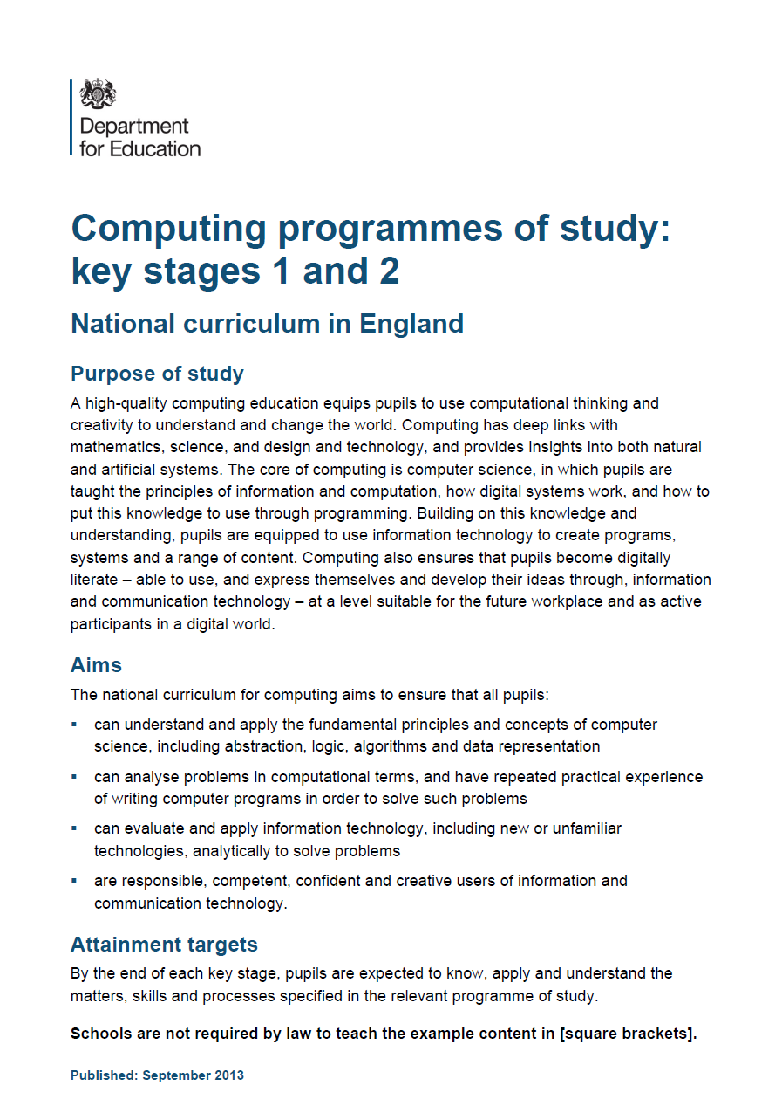

2014 – Changes to the National Curricullum

Slide 6
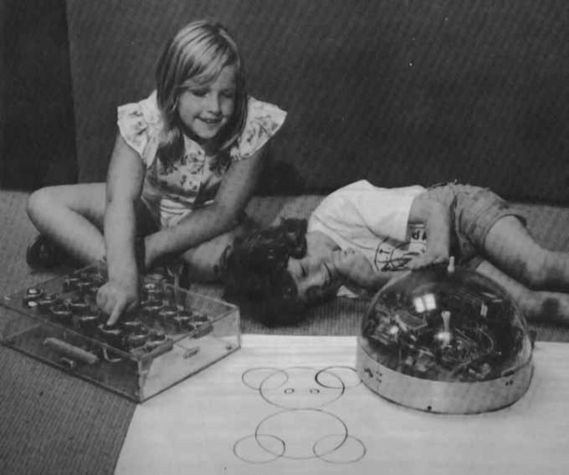
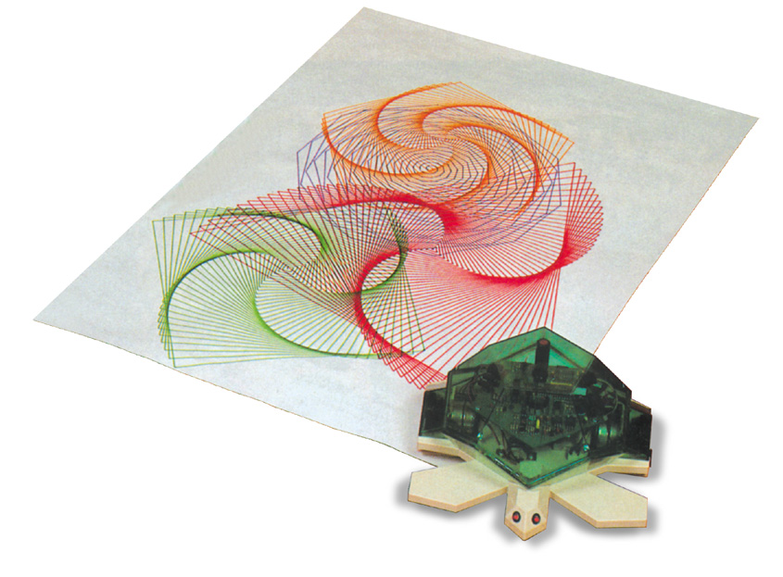
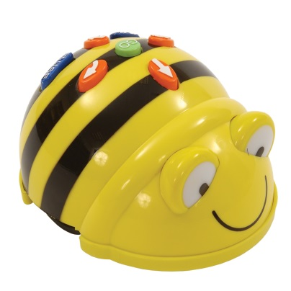
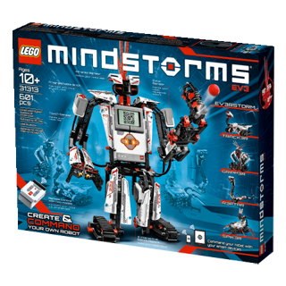
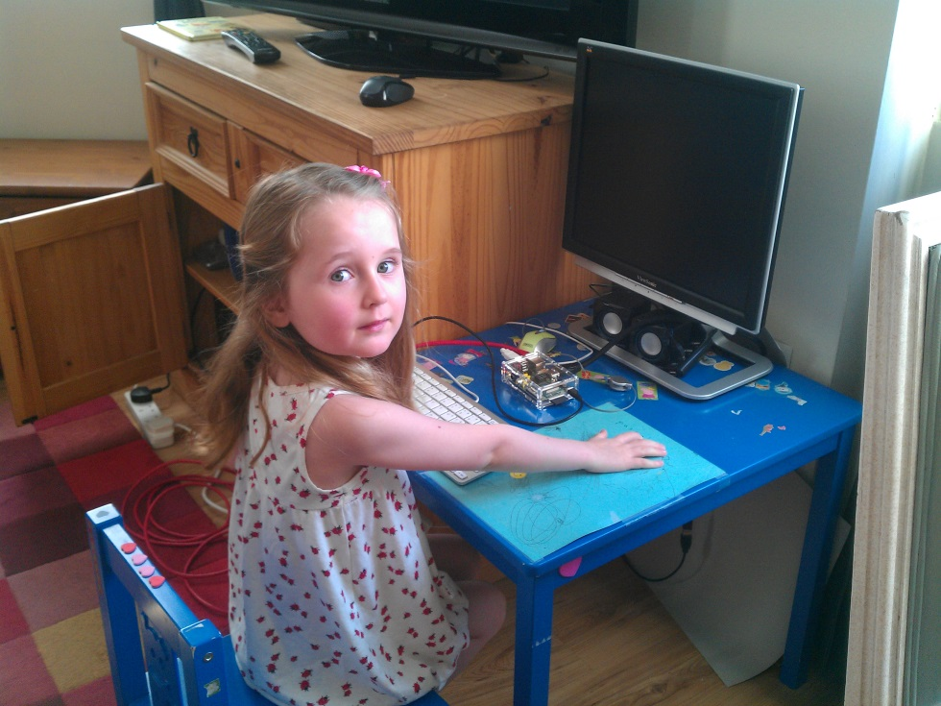
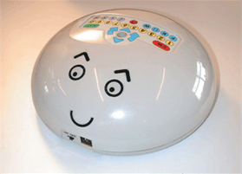
The funny thing is none of this is very new…
The ‘Valiant’ Turtle
Preface to Papert’s Mindstorms (1981)
The Raspberry PI
Bee-Bot
Lego Mindstorms
The ‘Valiant’ Roamer

Slide 7
How do two people have a conversation?
Pause this recording and write down a set of rules for a conversation.
How does a conversation begin, what happens in the middle, how does it end?

Slide 8
An ‘algorithm’…
…is a precisely defined procedure – a sequence of instructions, or a set of rules, for performing a specific task (e.g. instructions for changing a wheel or making a sandwich).
While all correct algorithms should produce the right answer, some algorithms are more efficient than others.
Computer scientists are interested in finding better algorithms, partly out of intellectual curiosity, and partly because improvements in algorithms can result in massive savings in terms of both cost and time.

Slide 9
Computational Thinking
Splitting problems into smaller parts is part of computational thinking.
For example, designing a game in Scratch will involve thinking about algorithms, programming, drawing sprites and backgrounds, making animations, and even composing music or recording sound effects.

Slide 10
Thinking forward to the Assignment
Small-scale, practical programming project
“The submitted project should feature learning through exploration or experimentation. In very simple terms, someone should learn something by doing something. It may be you doing the learning as the project’s developer, or someone else doing the learning as the project’s end user (perhaps a hypothetical school pupil) The ‘richer’ you can make the learning in the project, either for you as the developer or for someone as the user, the more potential there is for your project to do well.”
Assessment brings together two strands
Theoretical basis for using programming as a tool for learning
Developing an educational tool using Scratch
Each workshops should provide ideas on how to get started with the two strands and pull them both together

Slide 11
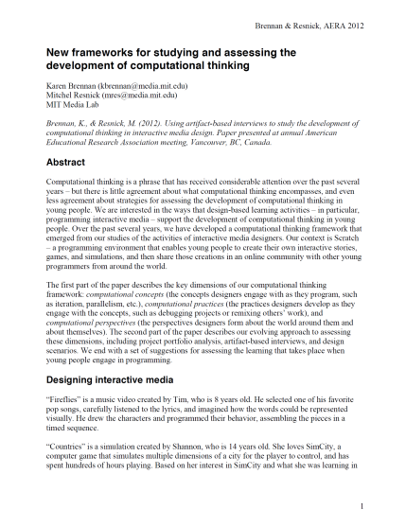








In advance of the next session…
Definitely read p1-11 and 22-24 of Brennan & Resnick (2012) on BB – and read the whole article if you have a chance
Explore the module content and look at the links to the multimedia provided
Have a play with Scratch and see if you can learn about these blocks and how they work

